Slide 1
Project meeting
2019.3.15

Slide 2
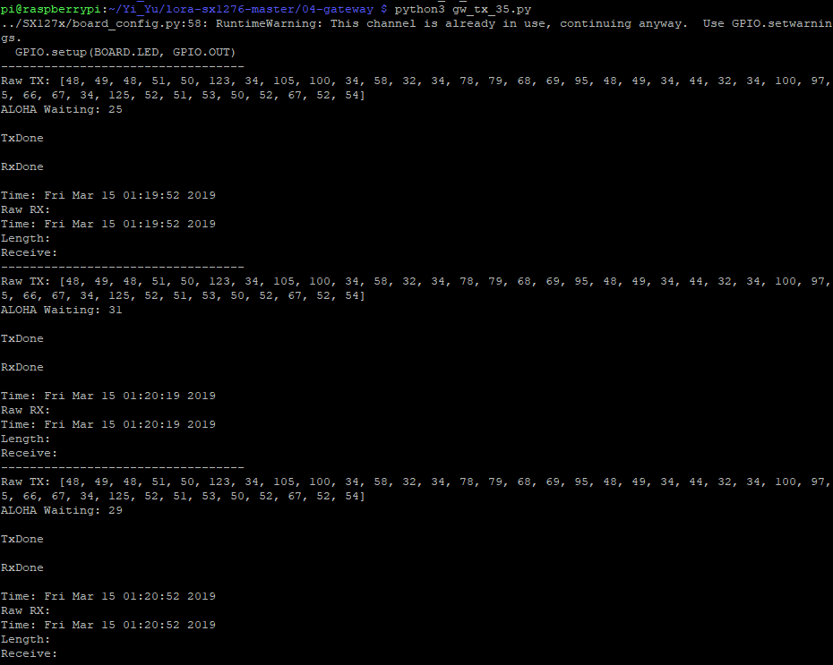
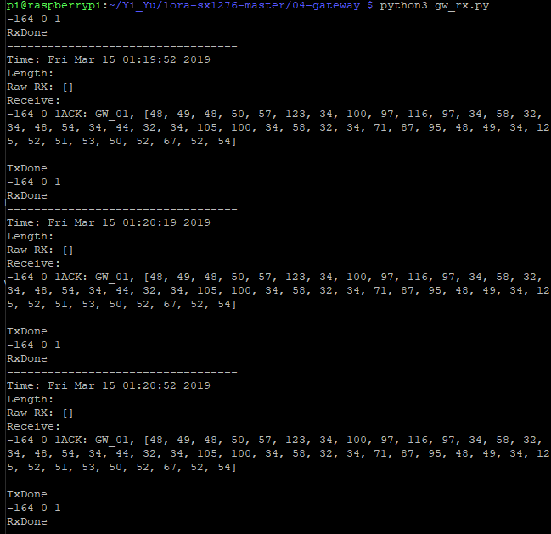
Sensor node’s data transmission
Gateway’s data receiving

Slide 3
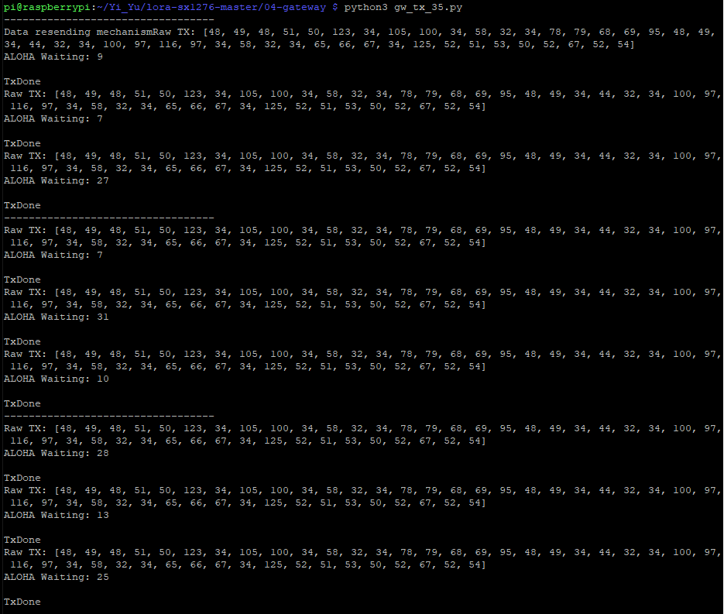
Data resending mechanism

